Slide 1
Food Ordering System in Restaurant
Prepared by:
Rojan Karki
Prakash Bhandari

Slide 2
The need for Food Ordering System
Customers POV
Service delay in restaurants
Modern solution
Misplace of order
Restaurant POV
Inability to take multiple orders
Difficulty in maintain bills

Slide 3
Background
Web based application
Interactive and user friendly system
3 types of user: customer, admin, kitchen

Slide 4
Problem Statement
To be dealt with large paperwork
Customer service
Human error
Unmanaged billing records
Need of more manpower

Slide 5
Related study/ literature review
Most restaurants still use traditional menu
Robot Serving system like in KKFC is expensive
Online food order and delivery eg. foodmandu
Manual order system

Slide 6
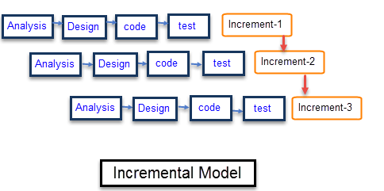
Methodology
Incremental software development model

Slide 7
Analysis
Requirement analysis
Feasibility study
Time feasibility
Budget feasibility
Hardware requirements
Server specifications
Software requirements
Web browsers
Operating systems

Slide 8
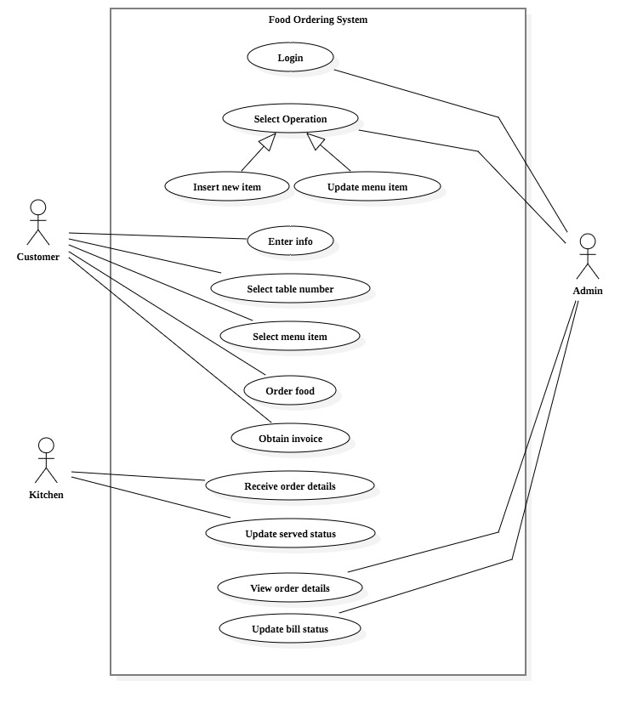
Use case diagram

Slide 9
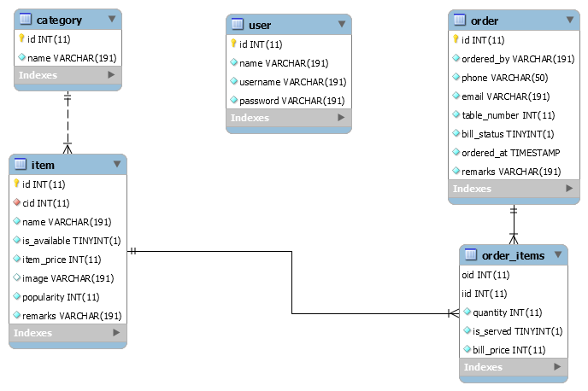
Design
Schema diagram
Design models of system
Schema diagram
Flowcharts
Sequence diagrams

Slide 10
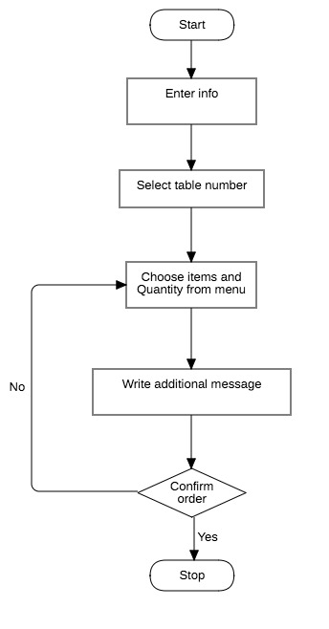
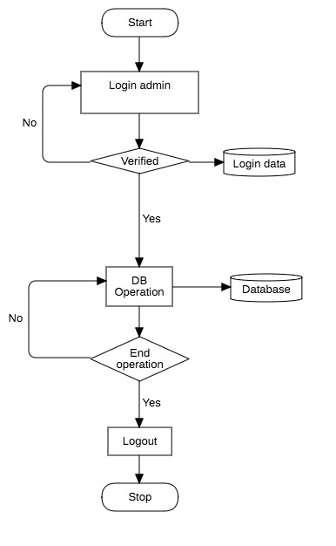
flowcharts
Customer flowchart
Admin flowchart

Slide 11
Coding
Front end development
HTML, CSS
JavaScript
Back end
Php
Database
MySQL

Slide 12
Testing
Unit testing
Integrated testing
system testing
Testing unit modules
Interaction among modules
Whole system test

Slide 13
How system works?

Slide 14
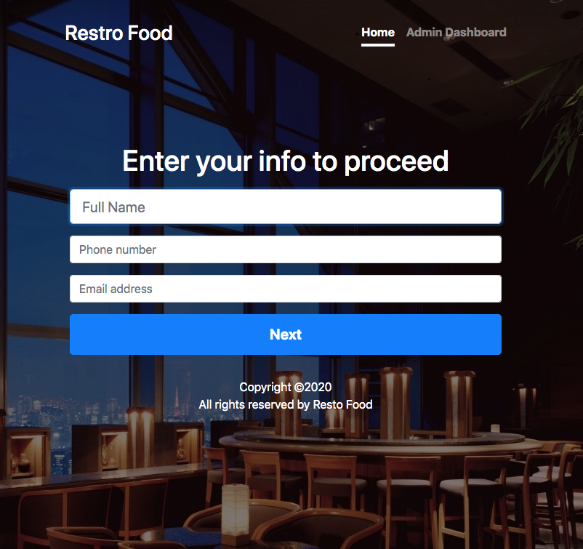
User input form

Slide 15
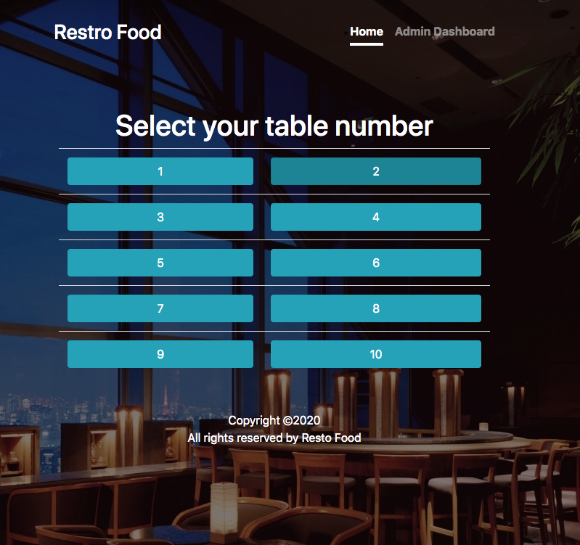
Table selection by customer

Slide 16
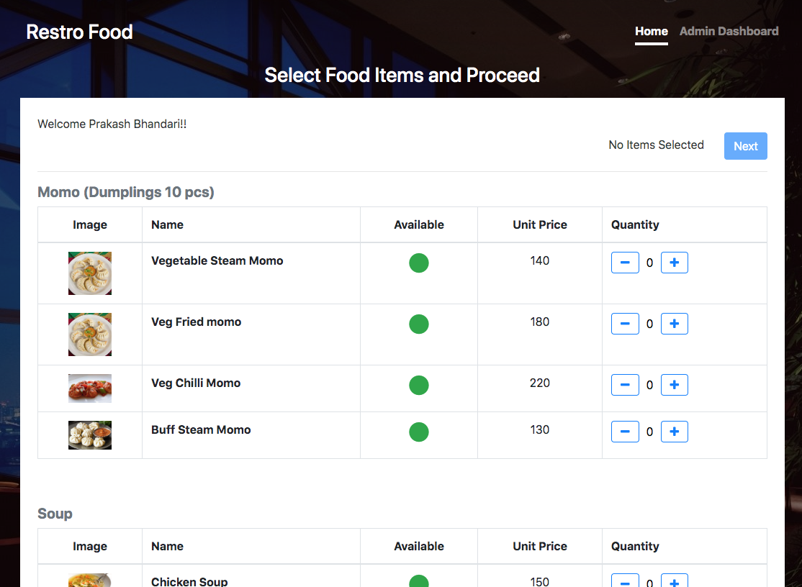
Menu item selection

Slide 17
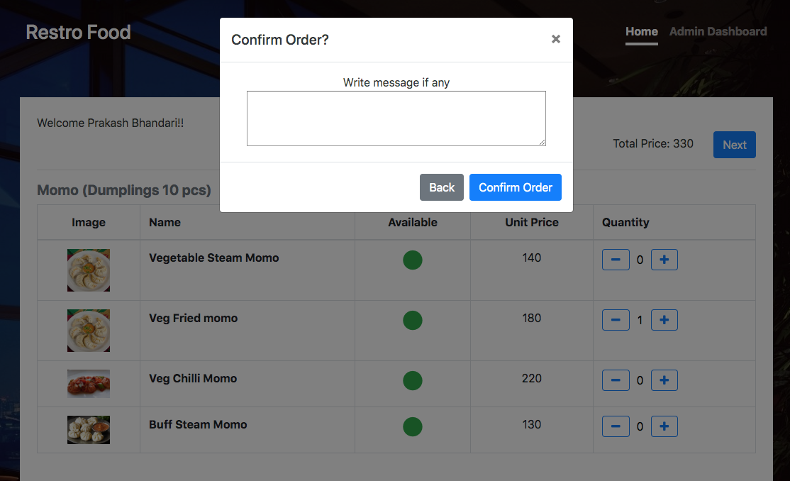
Order confirmation with message

Slide 18
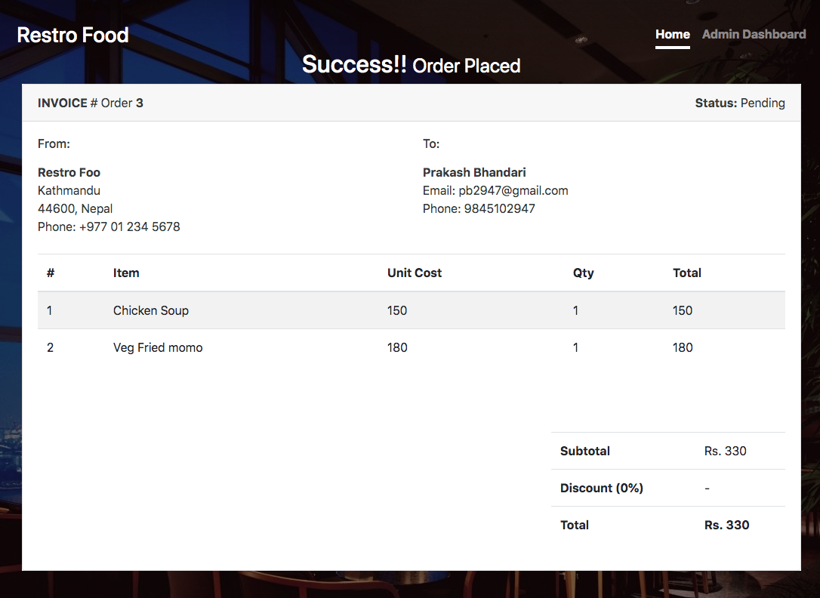
Order Invoice

Slide 19
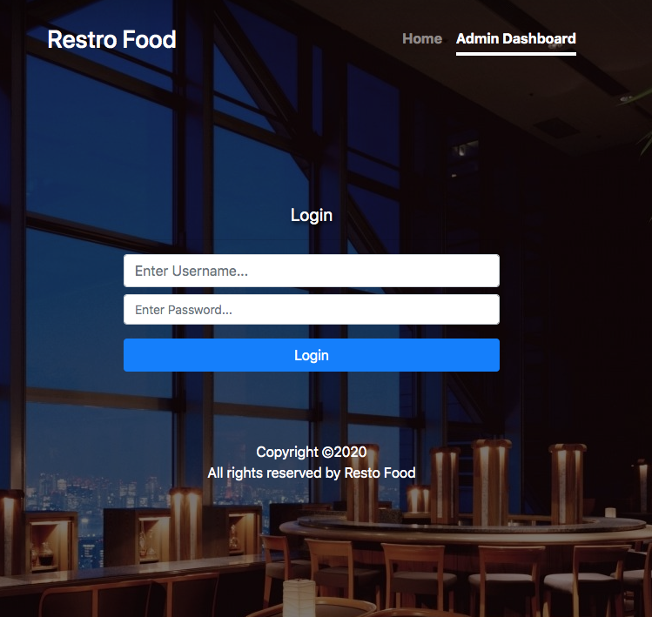
Admin login

Slide 20
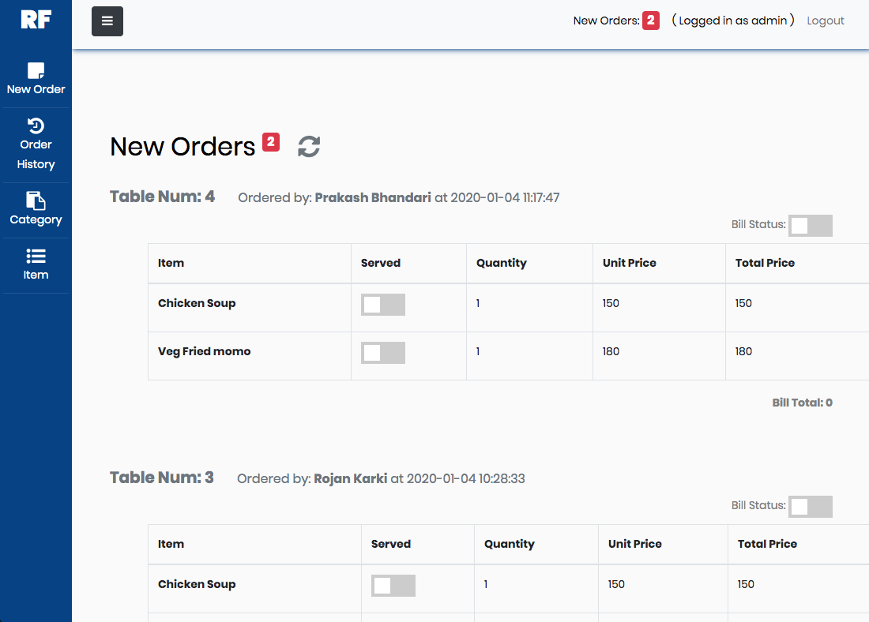
Admin dashboard

Slide 21
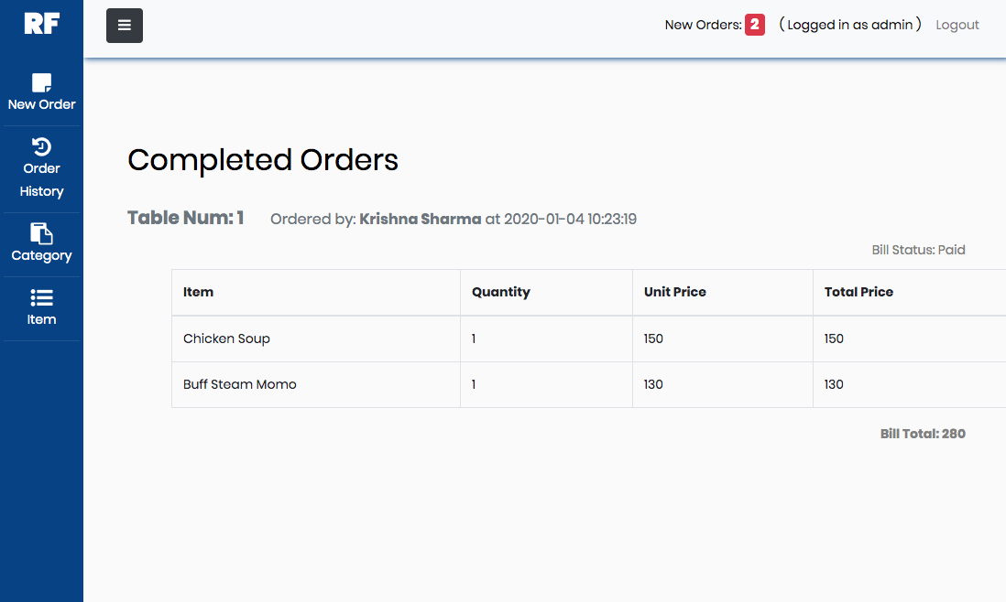
Order history

Slide 22
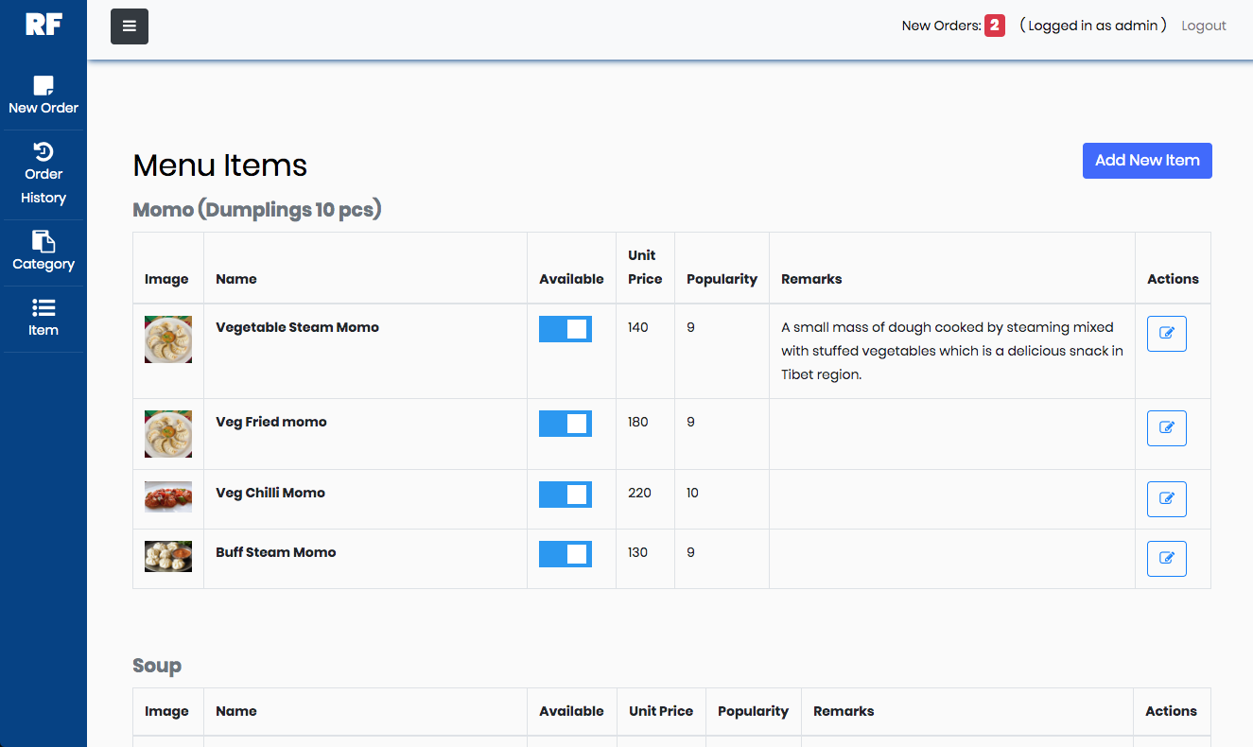
New item insertion in menu

Slide 23
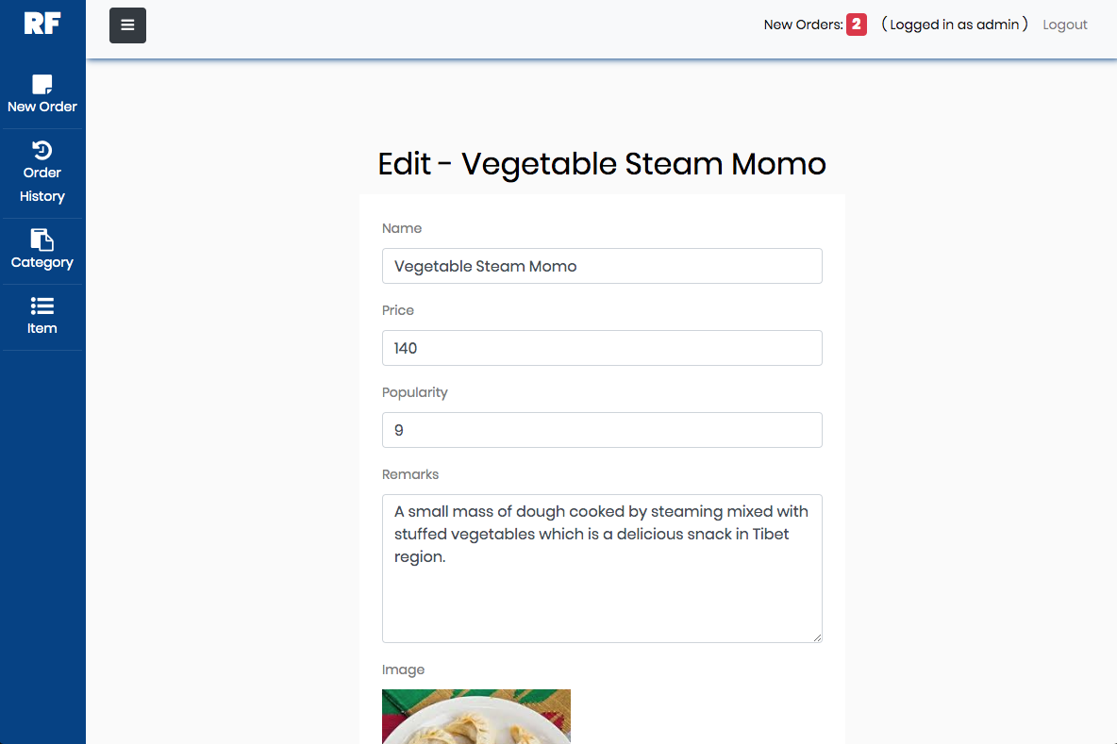
Menu update page

Slide 24
Results
Instant ordering system
Click and order digital menus
User friendly interface
Maintenance of order details
Real time notifications
Improved service
automated billing records
Handle multiple requests

Slide 25
Further works
more user involvement
User rating features
Suggestion by customer records
Offers based on regularity
Improved billing system
Integrating payment system

Slide 26
Thank you

